Slide 1
Loop and Condition
Hussein Alrubaye

Slide 2
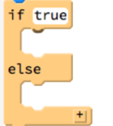
Condition
If (true)
// Run block 1 of code
Else
//Run block 2 of code

Slide 3
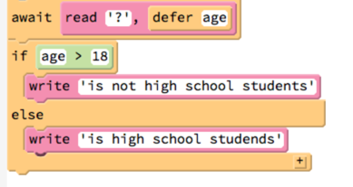
Task: Find high school students

Slide 4
Task(TODO): Enter degree and show level
>90 = A
80 -90= B
70-80= C
<70 = fail

Slide 5

Loops
for x in [0...10]
// Run block of code number of times

Slide 6
Task: print hello 10 times

Slide 7
Task: find x+x^x+x^3..

Slide 8
Task(TODO): Find class average

